Slide 1
Web Page and Server Basics
ITM 352

Slide 2
Module Objectives
Learn basics of
HTML:
Doc Type
Common tags (headers, paragraph, links, etc.)
Div and span and page layout
CSS:
Styles (fonts, widths, colors, etc.)
Placement (floats)
How web pages actually work
HTML, CSS, and the DOM

Slide 3
Module Objectives
Learn how to
Build a webpage from scratch (not a page builder)
Use webpage development tools
Chrome Web Developer tools
Use tools and online references
VS Code IntlliSense, Emmet boilerplate
W3 schools
Become aware of various frameworks and libraries and how to use them
Understand the benefits and limitations of website builders and web development tools (e.g. page builders such as Dreamweaver)

Slide 4
This Lecture
Will introduce
HTML, CSS in VS Code
Testing web pages with local http server
Google Web Tools (Chrome Dev Tools)
On your own
VS Code tutorial
Beginning and Intermediate HTML tutorial
CSS tutorial
Google Web Fonts
Chrome Dev Tools tutorial

Slide 5
Prerequisites
Before starting this module you should have installed and tested
Node.js
VS Code
Google Chrome browser (but other browsers and VS Code have similar tools)

Slide 6
Web Pages?
A web page is text document “requested” by a browser from a server
The server “responds” to the request by sending the document to the browser
The browser will process the document based on the document type and how the browser is configured
The server does not directly manipulate the document or browser after it is sent
The actual display of the page is handled entirely by the browser
The utility of this is that it enables centralized management of documents that are widely accessible and built from components on demand
Often dynamically from many sources (hence WWW)
The browser and server communicate requests for documents and responses in a special language called HTTP (hyper text transfer protocol)
You will need to be familiar with how this works if you want to build web applications

Slide 7
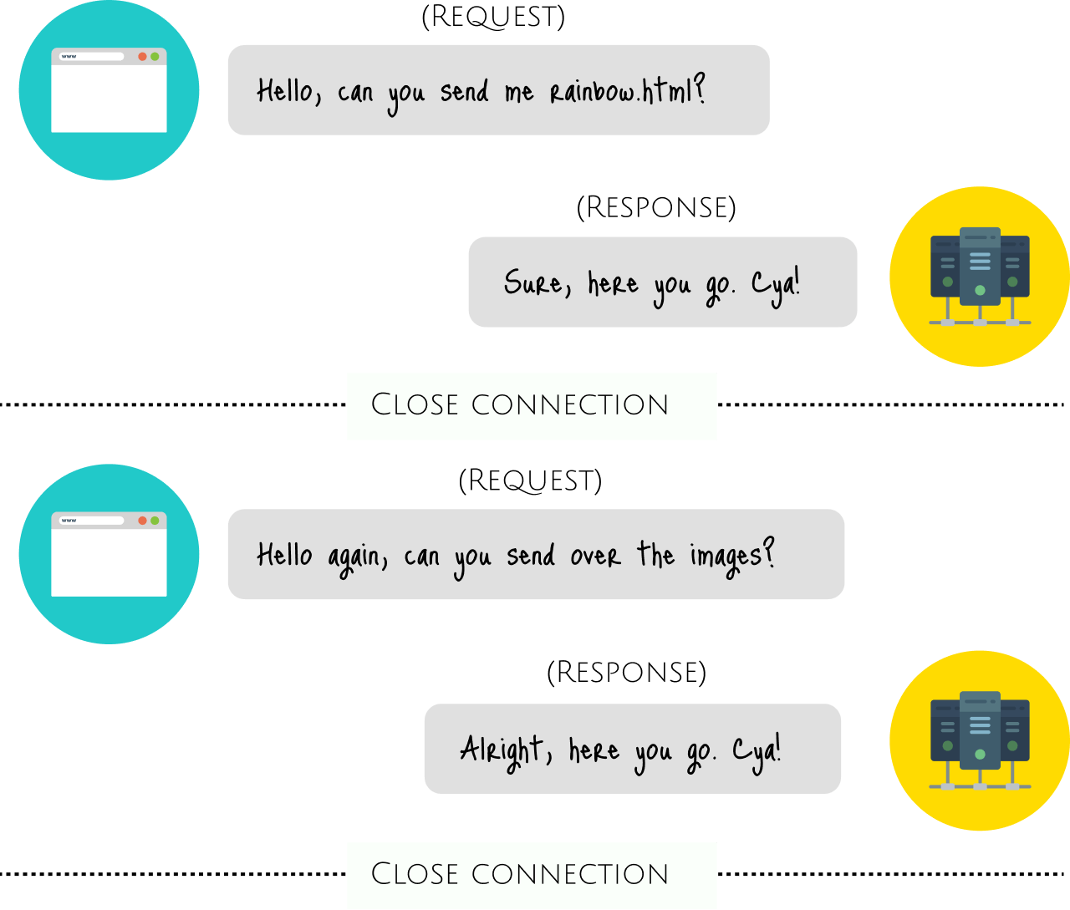
HTTP, Client-Server Comm
HTTP, which is what the web runs on, is different. It is known as a connectionless protocol, because it is based on a request/response mode of operation. Web browsers make requests to the server for images, fonts, content etc. but once the request is fulfilled, the connection between the browser and server is severed.

Slide 8
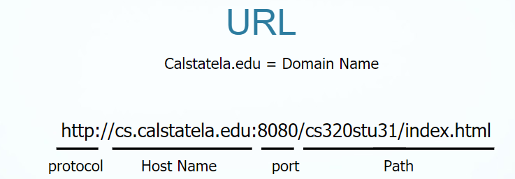
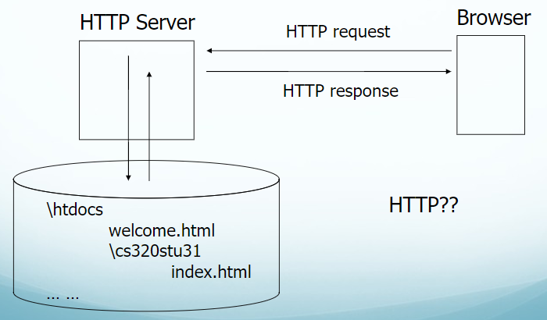
Web Server Root Directory
A web browser will translate a URL into an HTTP request
When the server receives an HTTP is then “routed” according to the configuration of the server (or the web app receiving the request).
The most basic route simply accepts the request and maybe responds with a message.
More complex routing uses the header information to programmatically respond or send the request to component or service
The basic web server routes requests to the servers file system. Get a file from the servers root directory and transfer contents to the requestor with an appropriate doctype (e.g. HTML) based on the file extension
cs.calstatela.edu
Requestor
port
Path

Slide 9
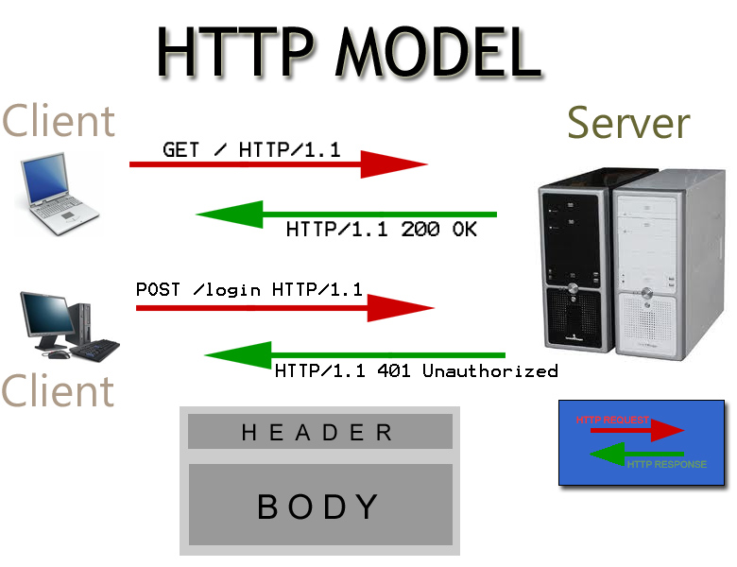
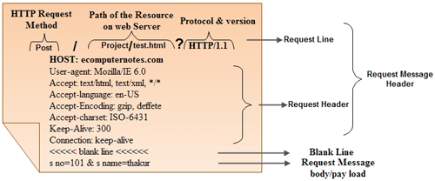
Web Page Processing
Browser is the “client” that requests via http a file from the server
This is called a “pull” or “get” request
There is also “push” but this is more complicated
Let’s see this “raw” using a browser
https://mkyong.com/computer-tips/how-to-view-http-headers-in-google-chrome/
Browser receives file and processes it as it has been configured
E.g. HTML text is “drawn” on the screen
Different browsers may process the file differently!
E.g. look of buttons, text boxes etc.
Do Exercise 1

Slide 10
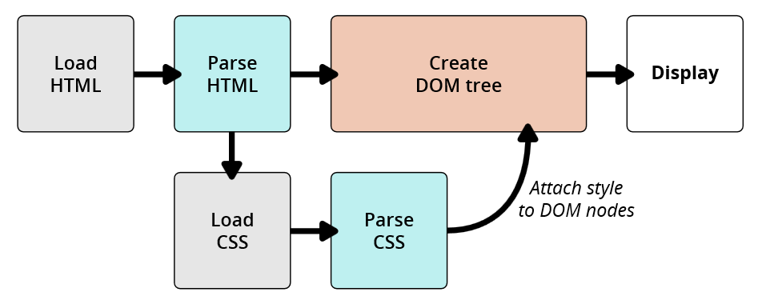
Web Pages: HTML, CSS, and the DOM
A web page is just plain text that comes from a server (or local file) containing “page markups” and directives that the browser interprets to build and display a page
The directives in the file are “processed” by the client application (e.g. a browser).
This this “front-end” or “client side” processing
Markups tell what the page should look like
HTML – Hyper Text Markup Language
Built into a web browser
It is NOT a programming language
There are many other markup languages (e.g. XML, Markdown)
A markup “tag” describes an “object” for the DOM
Objects are conceptual “things” with both “attributes” and “behaviors”
HTML tags are “page elements” that become DOM (Document object model) elements inside the “document” object. The document object is specified by the <HTML> tag.
The browser creates DOM objects and uses them to build and manage pages.
DOM objects are organized into “tree” that describe how objects are related.
Objects are not necessarily related by where they are located on a page!
CSS is a framework that sets attributes for DOM objects
It is independent of HTML!
Do Exercise 2,3,4

